Slide 1

From Association to Generation: Text-only Captioning by Unsupervised Cross-modal Mapping ———图复现
报告人：赵炳轩
西北工业大学
光电与智能研究院(iOPEN)

Slide 2
1.概述
内容
提出一种新的text-only的训练方法
创新
在训练以及推理过程中引入数据库，通过相似度计算，取Top K的数据作为条件输入decoder，减小数据跨模态影响。
Notes:
出现在[iOPEN]、[序号]、[中文文本间的英文、数字与符号]等的非中文字符可以采用微软雅黑。

Slide 3
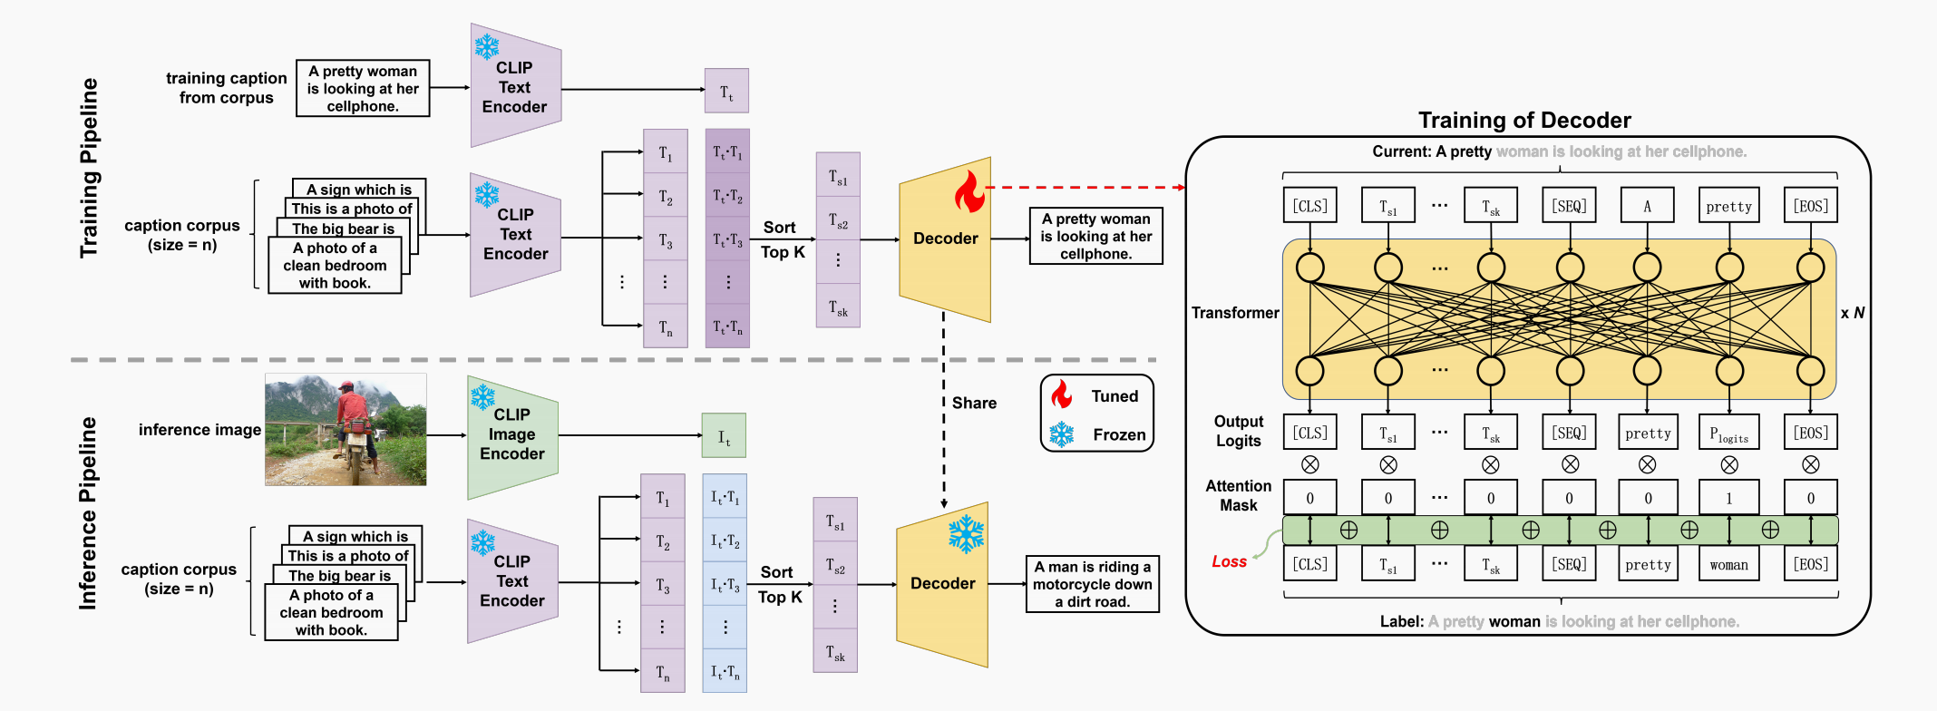
2.原图
Notes:
出现在[iOPEN]、[序号]、[中文文本间的英文、数字与符号]等的非中文字符可以采用微软雅黑。

Slide 4



























3.个人作图
Training Pipeline
Training of Decoder
training caption freom corpus
A pretty woman is looking at her cellphone
CLIP
Text
Encoder
$$T_{t}$$
Current: A pretty woman is looking at cellphone.
[CLS]
$$T_{s1}$$
...
$$T_{sk}$$
[SEQ]
A
pretty
[EOS]
$$T_{1}$$
$$T_{t}∙T_{1}$$
$$T_{s1}$$
A sign which is
$$T_{2}$$
$$T_{t}∙T_{2}$$
...
This is a photo of
Sort
Top K
A pretty woman is looking at her cellphone
caption corups
(size = n)
The big bear is
CLIP
Text
Encoder
$$T_{3}$$
$$T_{t}∙T_{3}$$
$$T_{s2}$$
Decoder
A photo of a clean bedroom with book
...
$$×N$$
...
...
...
$$T_{sk}$$
Transformer
$$T_{n}$$
$$T_{t}∙T_{n}$$
...
Inference Pipeline
Share
Tuned
Output
Logits
$$×$$
$$×$$
...
$$×$$
$$×$$
$$×$$
$$×$$
$$×$$
inference image
CLIP
Image
Encoder
$$I_{t}$$
Frozen
[CLS]
$$T_{s1}$$
$$T_{sk}$$
[SEQ]
pretty
$$P_{logits}$$
[EOS]
Attention
Mask
0
...
0
0
1
0
$$T_{1}$$
$$I_{ t }∙T_{1}$$
₊
0
0
₊
A sign which is
$$I_{t}∙T_{2}$$
$$T_{s1}$$
₊
₊
₊
₊
This is a photo of
$$T_{2}$$
Sort
Top K
A man is riding a motocycle down a dirty road.
...
caption corups
(size = n)
The big bear is
CLIP
Text
Encoder
$$T_{3}$$
$$I_{ t}∙T_{3}$$
$$T_{s2}$$
Decoder
Loss
[CLS]
$$T_{s1}$$
$$T_{sk}$$
[SEQ]
pretty
woman
[EOS]
A photo of a clean bedroom with book
...
...
...
...
$$T_{sk}$$
Label: A pretty woman is looking at cellphone.
$$T_{n}$$
$$I_{t}∙T_{n}$$
Notes:
出现在[iOPEN]、[序号]、[中文文本间的英文、数字与符号]等的非中文字符可以采用微软雅黑。

Slide 5
Key elements
轻微移动
关闭 视图-网格和参考线-对象与网格对齐
不关闭的情况下 Ctr+方向键
合并形状
合并形状-结合
0
画直线
划线的同时长按Ctr键。
Notes:
出现在[iOPEN]、[序号]、[中文文本间的英文、数字与符号]等的非中文字符可以采用微软雅黑。

